Slide 1
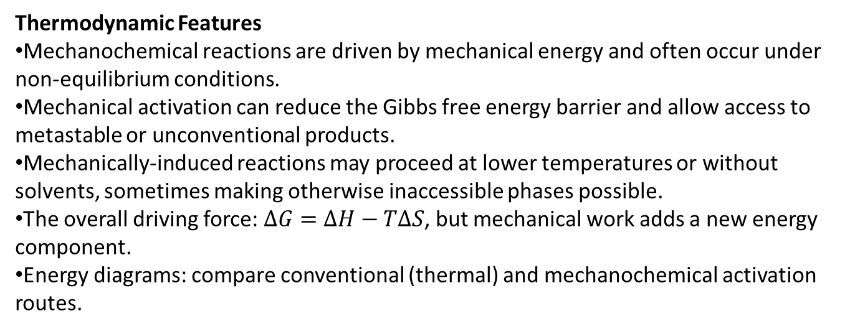
Thermodynamic Features
Mechanochemical reactions are driven by mechanical energy and often occur under non-equilibrium conditions.
Mechanical activation can reduce the Gibbs free energy barrier and allow access to metastable or unconventional products.
Mechanically-induced reactions may proceed at lower temperatures or without solvents, sometimes making otherwise inaccessible phases possible.
The overall driving force: $ΔG=ΔH−TΔS$, but mechanical work adds a new energy component.
Energy diagrams: compare conventional (thermal) and mechanochemical activation routes.

Slide 2
Kinetics Distinctions
Mechanochemical kinetics differ from classical solution/thermal kinetics.
Reactions happen at interfaces, surfaces, and defects generated during milling, grinding, or shearing.
Reaction rates can be controlled by:
Rate of defect generation,
Surface area changes,
Mixing efficiency and contact between reactants,
Local temperature spikes ("hot spots").
Typical kinetic observations: sigmoidal rate curves, induction periods, autocatalytic acceleration.
Activation energy can be effectively lowered by mechanical treatment.

Slide 3
Energy Input and Dissipation
Only a small portion of mechanical energy applied to a solid is stored as useful chemical potential (defects, new surfaces, lattice strain).
The rest is dissipated as heat, sound, and plastic deformation.
Visualization: Pie chart of energy partitioning in typical mechanochemical experiments.
Efficient mechanochemical processing optimizes storage of energy in reactive sites.

Slide 4
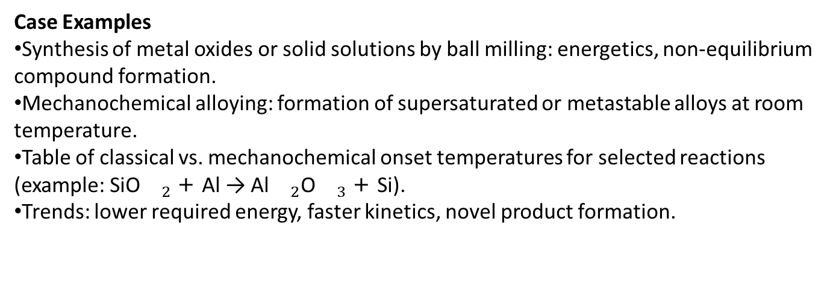
Case Examples
Synthesis of metal oxides or solid solutions by ball milling: energetics, non-equilibrium compound formation.
Mechanochemical alloying: formation of supersaturated or metastable alloys at room temperature.
Table of classical vs. mechanochemical onset temperatures for selected reactions (example: SiO${}_{2}$ + Al → Al${}_{2}$O${}_{3}$ + Si).
Trends: lower required energy, faster kinetics, novel product formation.

Slide 5
Measuring and Modeling
Reaction progress is measured by calorimetry (DSC), X-ray diffraction, and in situ monitoring.
Kinetic parameters (rate constants, activation energies) are determined by isothermal/isothermal experiments, often non-trivial due to discontinuous material handling.
Empirical kinetic models: Johnson–Mehl–Avrami–Kolmogorov (JMAK), grain growth models.
Simulations: energy landscapes, mechanistic insights from computational chemistry.

Slide 6
Summary and Discussion
Mechanochemical thermodynamics involve unique non-equilibrium pathways and energetic landscapes.
Kinetics are strongly governed by defect chemistry, surfaces, and heterogeneous energy input.
Mechanochemistry allows the synthesis of new materials under mild conditions with energy-efficient processes.
Discussion prompts: How could you exploit non-equilibrium mechanochemical pathways for the synthesis of new functional materials? What experimental tools would you use to disentangle energy storage from dissipation?

